Slide 1
In this segment
Sockets Overview
Introduction
Data Structures
Library Calls
General Operation
Socket Example

Slide 2
Socket - Introduction
What is it ?
Socket is an internal endpoint for sending/receiving data within a node on network
Berkeley/POSIX sockets defined API for Inter Process Communication (IPC) within same host (BSD 4.2 – circa 1983)
Early form of Middleware (limited to same host systems)
Windows variant (WinSock) based on BSD Sockets.
Treated similar to files in BSD/POSIX
Maintained in File Descriptor table
Supported protocols
TCP/IP – IPv4, IPv6
UDP

Slide 3
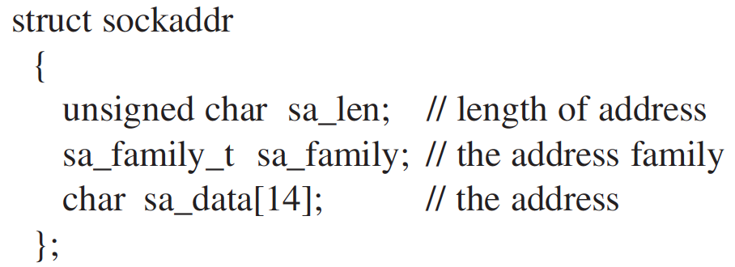
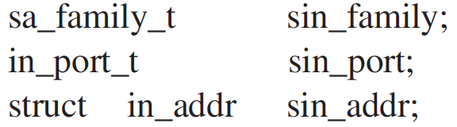
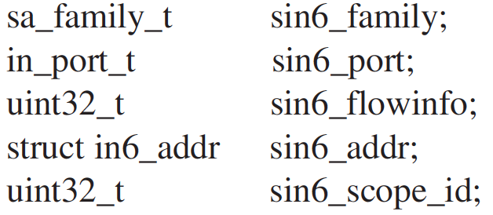
Socket – Data Structures
Socket Address
Defined in sys/socket.h
Address length is 8 bytes by default
Family – Denotes the family of protocol (TCP, UDP)
Address contains – host and port
Socket Address family TCP/IP
IPv4 - sockaddr_in
IPv6 - sockaddr_in6

Slide 4
Socket – Library Calls
Socket APIs
socket —creates a descriptor for use in network communications
connect —connect to a remote peer (client)
write —send outgoing data across a connection
read —acquire incoming data from a connection
close —terminate communication and deallocate a descriptor
bind —bind a local IP address and protocol port to a socket
listen —set the socket listening on the given address and port for connections from the client and set the number of incoming connections from a client (backlog) that will be allowed in the listen queue at any one time
accept —accept the next incoming connection (server)
recv —receive the next incoming datagram
recvmsg —receive the next incoming datagram (variation of recv)
recvfrom —receive the next incoming datagram and record its source endpoint address
send —send an outgoing datagram
sendmsg —send an outgoing datagram (variation of send)
sendto —send an outgoing datagram, usually to a prerecorded endpoint address
shutdown —terminate a TCP connection in one or both directions
getpeername —after a connection arrives, obtain the remote machine’s endpoint address from a socket
getsockopt —obtain the current options for a socket
setsockopt —change the options for a socket

Slide 5
Socket – General Operation
Lifecycle

Slide 6
Socket – Example
Server code
int main()
{
int server_socket_fd, client_conn_fd;
int client_addr_size;
struct sockaddr_in server_addr, client_addr;
int port_number;
char message_from_client[256];
char message_from_server_to_client[256];
int client_message_length, server_message_length;
// Set the port number
port_number = 1132;
// Create the socket for the server to listen on
server_socket_fd = socket( AF_INET,
SOCK_STREAM,
0
);
if (server_socket_fd < 0)
PrintError(“ERROR opening socket”);
// clear out the server address to make sure no problems with binding
// if the address is clear then it won’t think the address has
// already been used by another socket
bzero( (char *) &server_addr, sizeof(server_addr));
// set the sockaddr_in struct appropriately
// note that this assumes IPv4
server_addr.sin_family = AF_INET;
server_addr.sin_addr.s_addr = INADDR_ANY;
server_addr.sin_port = htons(port_number);
// Bind the socket descriptor to the address
if (bind( server_socket_fd,
(struct sockaddr *) &server_addr,
sizeof(server_addr))
<0)
PrintError(“binding to socket failed”);
// Start the server listening on the socket
// limit the number of connections in the listen queue to 3
// (this is the backlog)
listen(server_socket_fd, 3);
while (1)
{
// clear out the client address to make sure no problems with accepting
// on this address
// if the address is clear then it won’t think the address has
// already been used by another socket
bzero( (char *) &client_addr, sizeof(client_addr));

Slide 7
Socket – Example
Server code
// accept a connection from a client
// on the open socket
client_addr_size = sizeof(client_addr);
client_conn_fd = accept( server_socket_fd,
(struct sockaddr *) &client_addr,
(socklen_t *) &client_addr_size
);
if (client_conn_fd < 0)
PrintError(“the accept failed”);
// Clear out the character array to store the client message
// to make sure there’ s no garbage in it
bzero(message_from_client, 256);
// read the message from the client
client_message_length = read( client_conn_fd,
message_from_client,
255
);
if (client_message_length < 0)
PrintError(“ unable to read from socket” );
cout << “ message is” << message_from_client << endl;
// Now write a message back to the client
// Doing a little mixed mode C++ strings and char buffers
// just to show you how
string mystring;
mystring = “ Server received from client, then echoed back to client:” ;
mystring += message_from_client;
bzero(message_from_server_to_client, 256);
mystring.copy(message_from_server_to_client, mystring.length() );
server_message_length = write( client_conn_fd,
(char *) message_from_server_to_client,
strlen(message_from_server_to_client)
);
if (server_message_length < 0)
PrintError(“ unable to write to socket” );
sleep(5); // let the client close first, avoids socket address reuse issues
close(client_conn_fd);
} // end while (1)
close(server_socket_fd); // this isn’ t reached because we used while (1)
// but with a different while loop test condition
// this would be important
return 0;
}

Slide 8
Socket – Example
Client code
int main()
{
int socket_fd;
struct sockaddr_in serv_addr;
int port_number;
char * IP_address;
char client_message[256];
int message_result;
// Set the IP address (IPv4)
IP_address = new char [sizeof(“ 127.0.0.1” )];
strcpy(IP_address, “ 127.0.0.1” ); // could instead have copied “ localhost”
// Set the port number
port_number = 1132;
// Create the socket
socket_fd = socket( AF_INET,
SOCK_STREAM,
0
);
if (socket_fd < 0)
PrintError(“ ERROR opening socket” );
// clear out the server address to make sure no problems with binding
bzero((char *) &serv_addr, sizeof(serv_addr));
// set the sockaddr_in struct appropriately
serv_addr.sin_family = AF_INET;
serv_addr.sin_port = htons(port_number);
// Use the inet_pton function to convert the IP address to
// binary
if (inet_pton( AF_INET,
IP_address,
&serv_addr.sin_addr
)
< 0
)
PrintError(“ Unable to convert IP address to binary to put in serv_addr” );
// Connect to the server
if (connect( socket_fd,
(struct sockaddr *)
&serv_addr,
sizeof(serv_addr)
)
<0
)
PrintError(“ unable to connect to server” );
cout << “ Enter message to send to server: ” ;
bzero(client_message,256);

Slide 9
Socket – Example
Client code
string mystring;
getline(cin, mystring); // read the line from standard input
cout << endl;
strcpy(client_message,mystring.c_str());
// Write the message to the socket to send to the server
message_result = write( socket_fd,
client_message,
strlen(client_message)
);
if (message_result < 0)
PrintError(“unable to write to socket”);
// Read the return message from the server
bzero(client_message,256);
message_result = read( socket_fd,
client_message,
255
);
if (message_result < 0)
PrintError(“unable to read from socket”);
cout << client_message << endl;
// close(socket_fd); // commented out because only close it if you
// don’t want to do more calling the server from
// a run of the client
delete [] IP_address; // return the memory to the heap
return 0;
}

